Slide 1
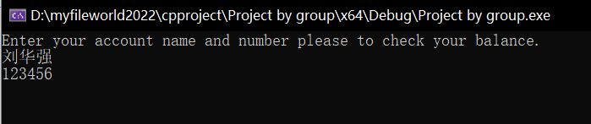
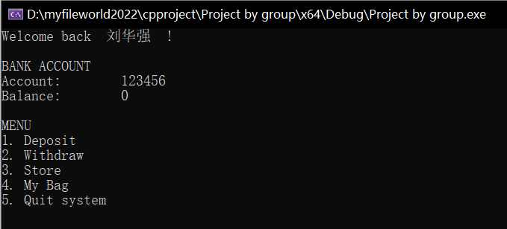
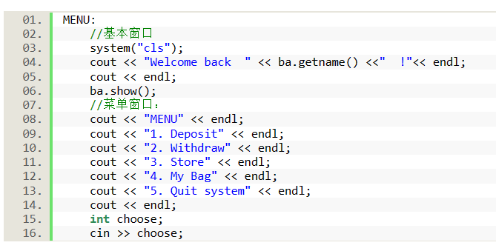
C++ Project “ the Trade System ”
A trading system with account included which is available to deposit, withdraw and purchase.
Prod by. Zhang Zhilin /Shi Haoyang Group 23

Slide 2
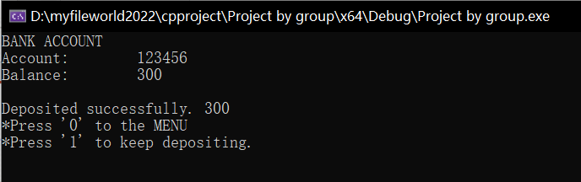
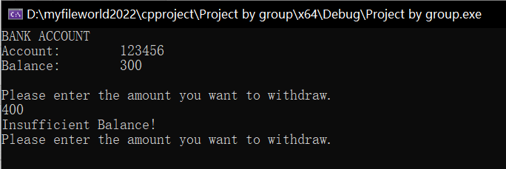
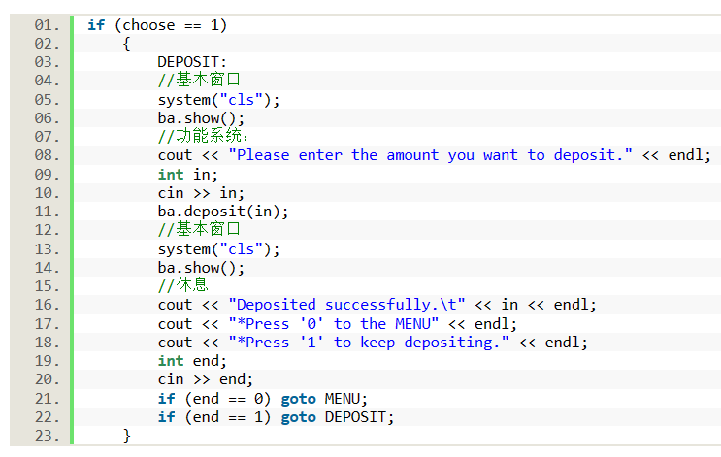
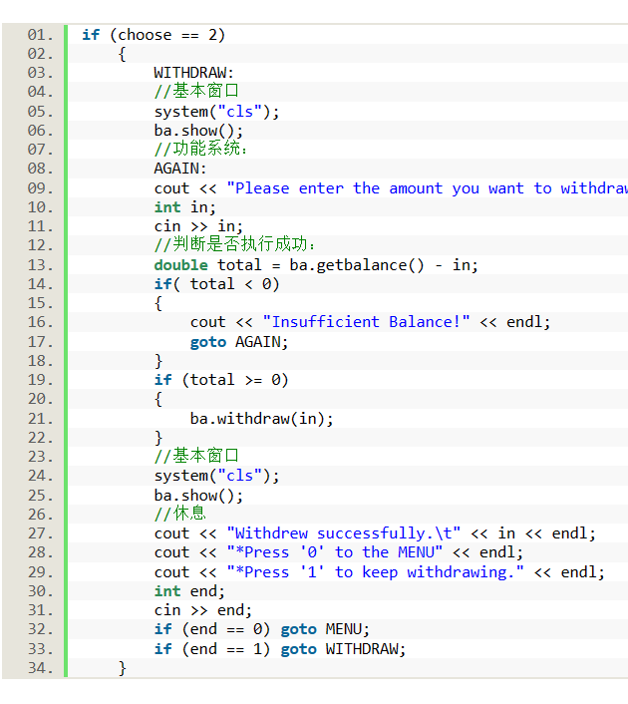
Deposit&Withdraw
Function part code details

Slide 3

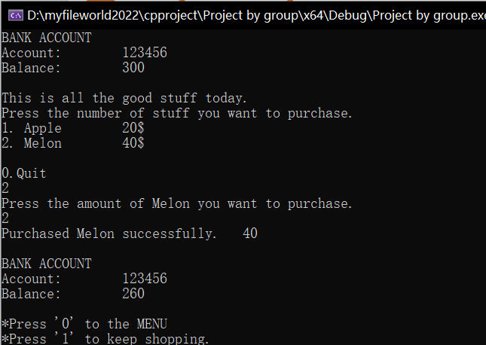
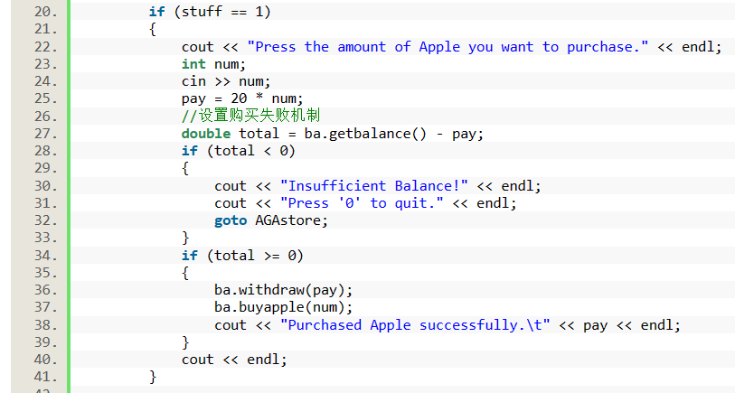
Shopping
Output example
Function part code details

Slide 4
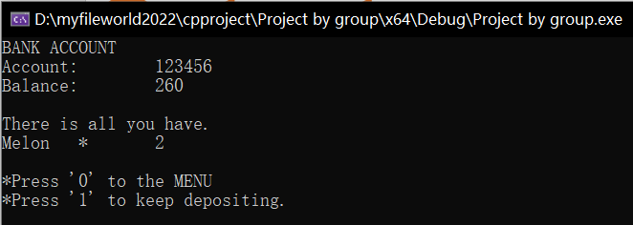
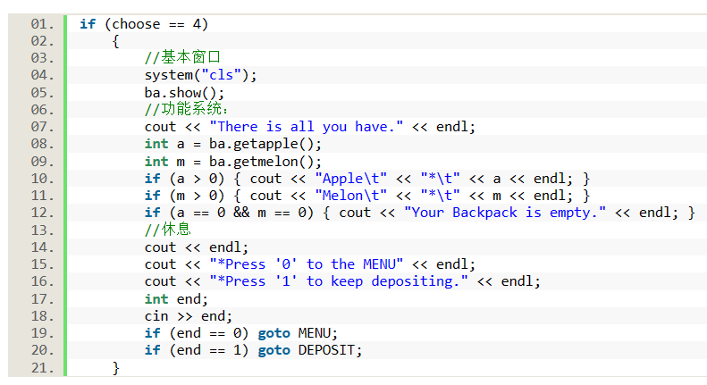
Backpack
Output example
Function part code details

Slide 5
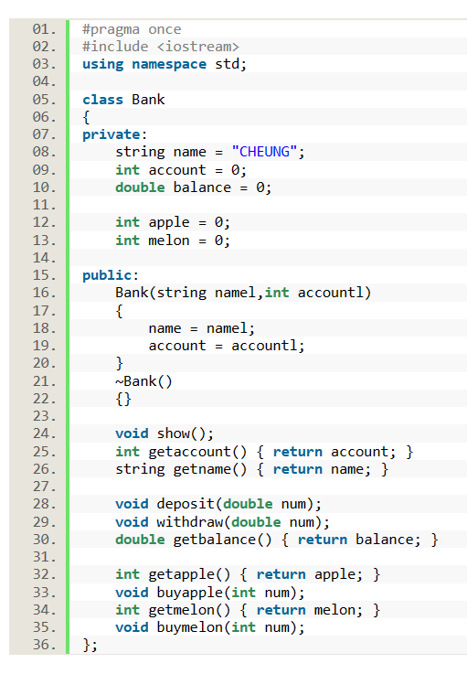
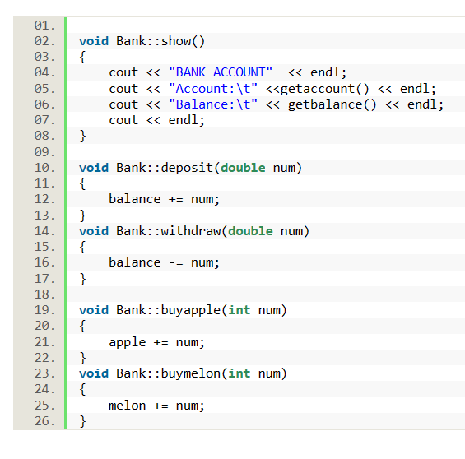
设定【类】 bank
【类】内声明
【类】外定义
Prod by. Zhang Zhilin /Shi Haoyang
Thank you for watching.

